Slide 1
PHENOMENAL
PENTAGON

Slide 2
Action Plan

Slide 3
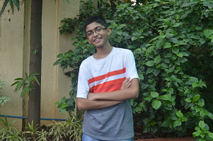
Aryan Karkera
The Leader
Also the chief editor of this group. He will direct the work and do the final changes

Slide 4
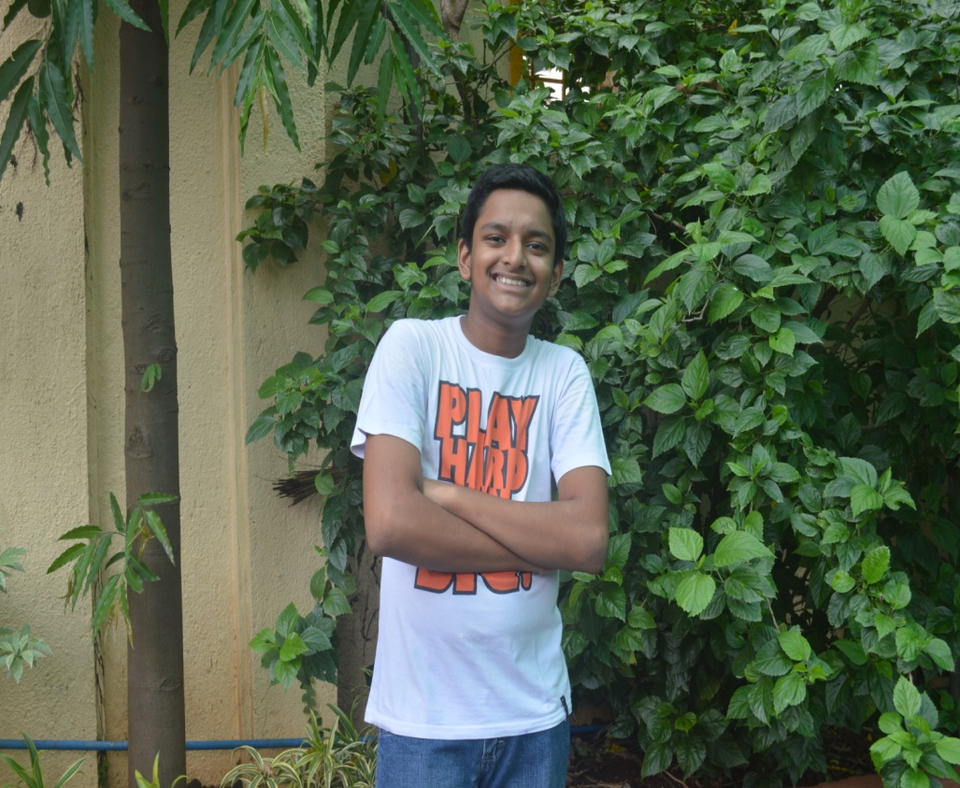
Yash Seth
The editor
He will edit the information and pass it to the leader for final touches.

Slide 5
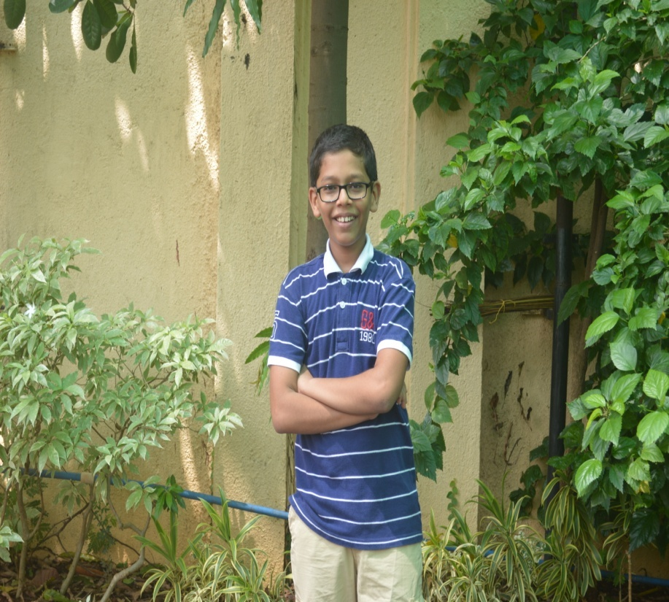
Pratyush Rajgor
The interviewer
He will interview the people and gather information

Slide 6
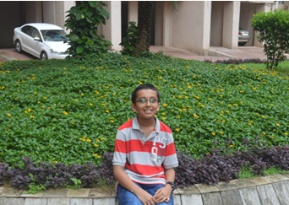
Jimit Shah
The Videographer
He will take videos and accompany the interviewer.

Slide 7
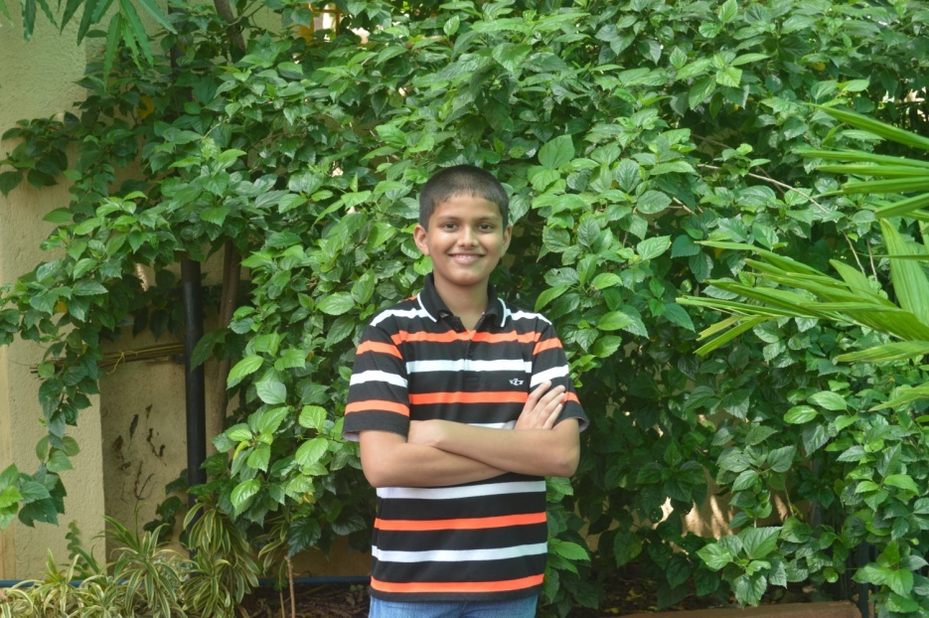
Ayush Parab
The Photographer
He will click photographs and edit those photos to perfection

